Slide 1

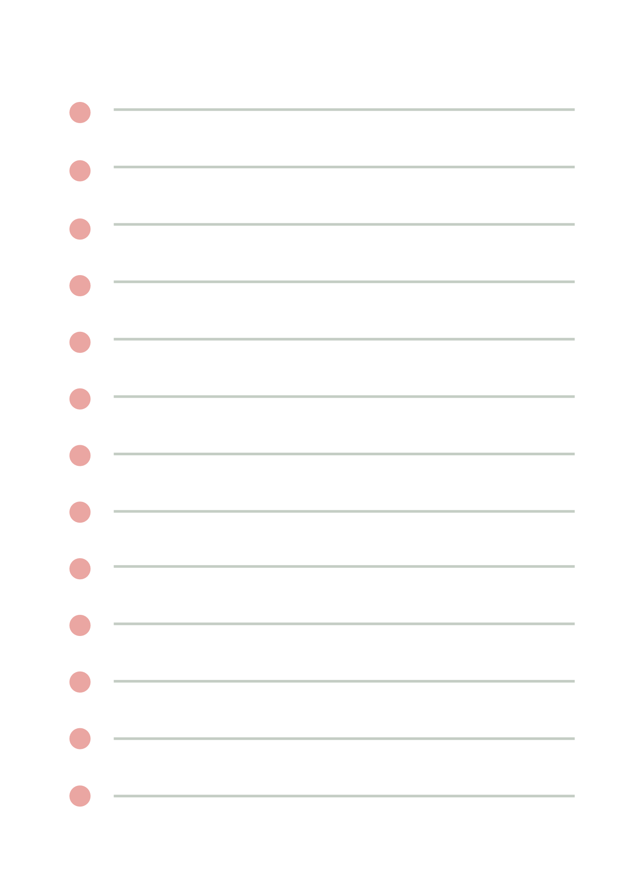




Automation deploy, monitor cloud infrastructure of web application

Slide 2




Team members
Nguyễn Văn Toản - PTIT
Nguyễn Văn Hùng - PTIT
Nguyễn Quang Đăng - UET
Mentor: Phùng Huy Hoàng

Slide 3

Tasks
NGUYỄN VĂN HÙNG
NGUYỄN QUANG ĐĂNG
NGUYỄN VĂN TOẢN
Explore AWS
Explore IaC
Explore CI/CD
System Deployment
Explore AWS
Explore IaC
Explore Docker
System Deployment
Explore AWS
Explore IaC
Explore Monitoring
System Deployment

Slide 4


Content
1
Introduction
2
System architecture
3
High availability & Security
4
Deploy the system with Terraform
5
Conclusion

Slide 5
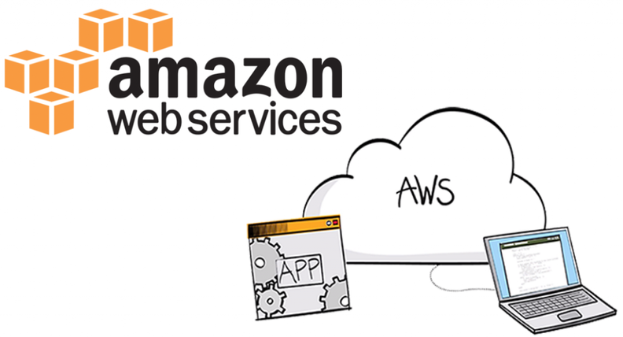


Introduction
1. Project Name: Automation deploy, monitor cloud infrastructure of web application
2. Target: Ensure stable and secure system operation with security measures on AWS.

Slide 6
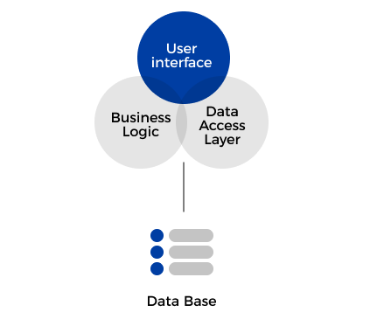
System architecture
Monolithic
Advantages
Disadvantages

Slide 7
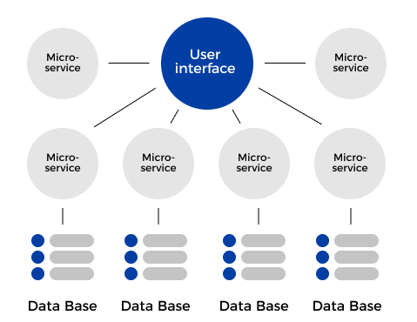
System architecture
Microsevice
Advantages
Disadvantages

Slide 8
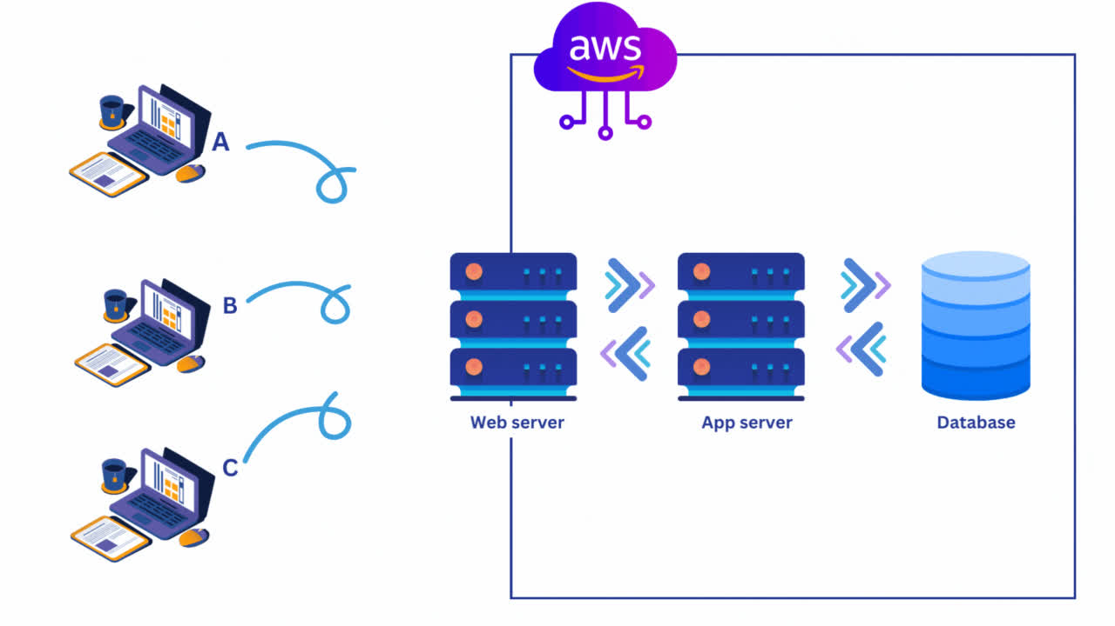
System architecture
What is Three-tier architecture?
2. Why is Three-tier architecture?

Slide 9
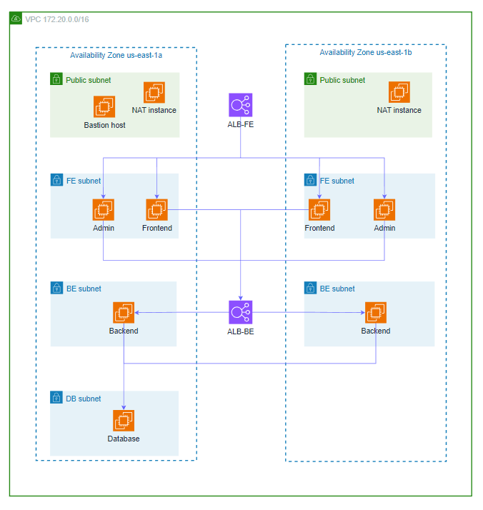
High availability
1. High Availability
2. Measures implemented for HA
3. Suggestions to improve HA

Slide 10
Security
1. Measures implemented for security
2. Suggestions to improve security

Slide 11
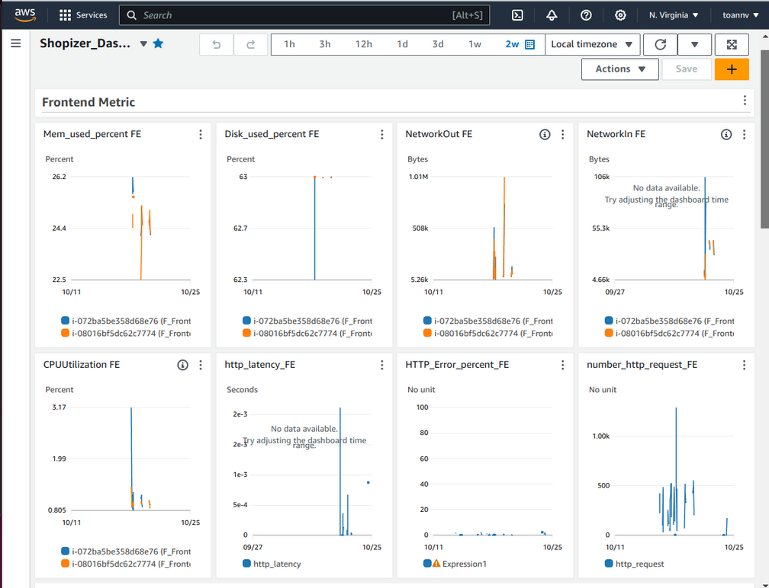
Monitoring
1. Purpose and Role of the Monitoring System
2. CloudWatch Service

Slide 12
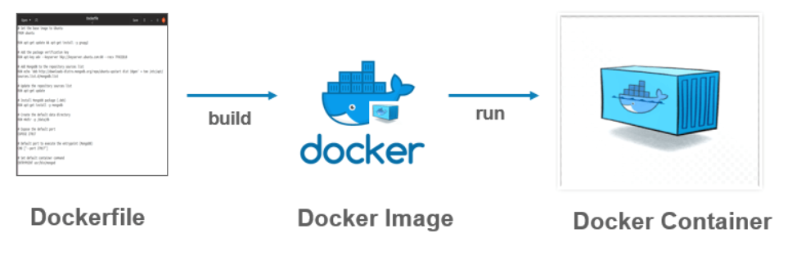
Deployment
1. Challenges encountered during deployment
2. Docker
3. Benefits of Docker

Slide 13
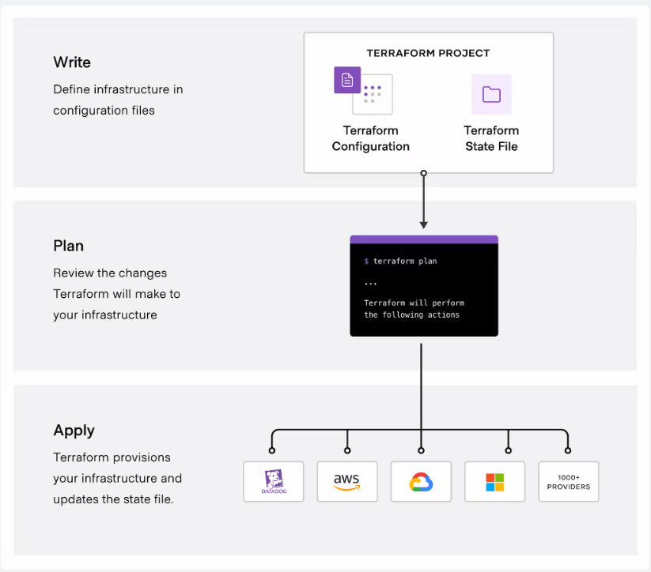
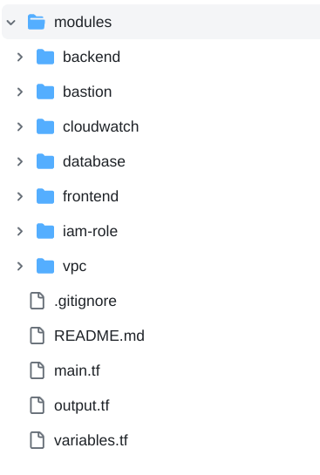
Deploying Systems with Terraform
1. What is Terraform?
2. How is Terraform Implemented?

Slide 14

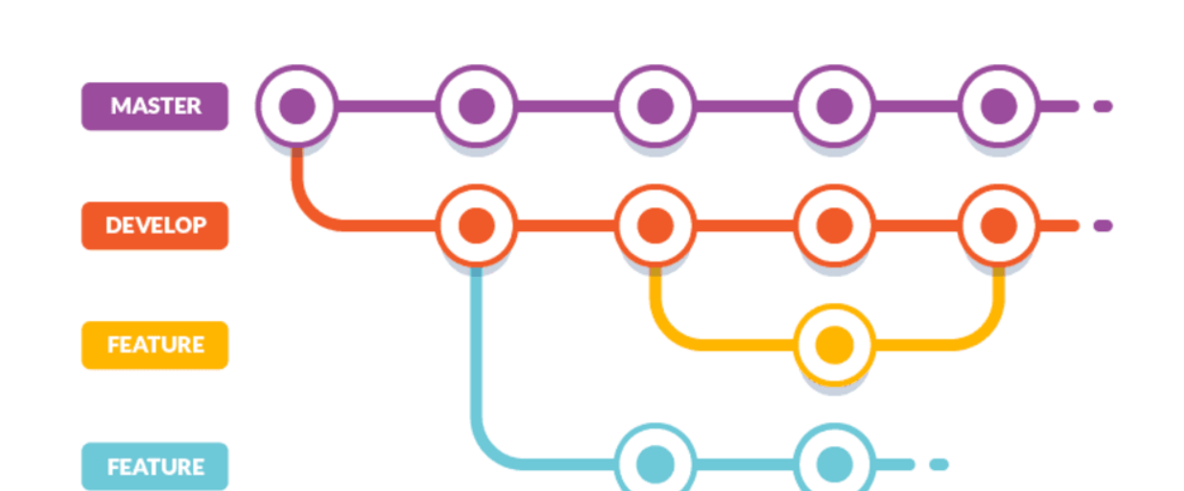

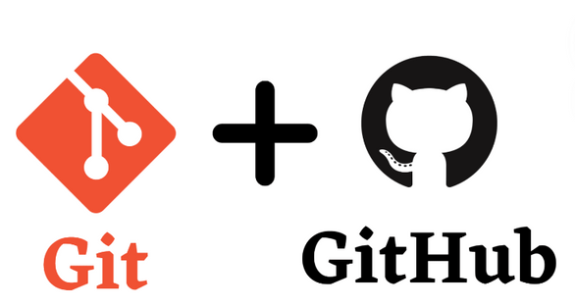
Using Git in Teamwork

Slide 15

Demo

Slide 16

Conclusion
01
02
The application has been deployed on AWS
Ensure basic high availability and security
Working with some basic AWS services
Enhance High Availability (HA) and security
Building a more comprehensive monitoring system
Apply CI/CD to project

Slide 17

Thank you

